Slide 1
Eunice Public School District
Culturally and Linguistically Responsive Framework

Slide 2
CLR Framework
Curriculum.
Learning Environment
Instructional Delivery

Slide 3
CLR Framework
Calendar
Professional Development
Family engagement

Slide 4
Curriculum
From Strategic Plan 2018 – 2020:
What does this mean? Curriculum and instructional alignment ensure that what is taught and how it is taught is thoughtfully planned and effectively executed by the entire instructional staff. What students learn, how they learn it, and when they learn it are how academic expectations can be raised and programs and lessons which are meaningful can be implemented to prepare students for tomorrow’s world.
Why is this important? Aligning the instructional program district wide both vertically (the entire Pre-K - 12 continuum) and horizontally (within grade levels) is the key to instructional excellence. Instructional alignment brings the entire system, from classroom to support to extracurricular, into a focused effort to attain a rigorous academic experience in which all students excel, and which raises academic achievement for all.
What we will do to address this focus area? Systemically measure, analyze, and act upon student learning data. Create leadership teams and content aligned teams to analyze data. Teams will create learning targets and pathways to achieve increases in academic achievement, revisiting progress with aligned short-cycle assessments or common formative assessments every 30-60-90 days. Commit time and resources for meaningful collaboration and high-quality professional development. Create differentiated and purposeful PLC calendar at each school campus. Invest in continued support for instructional coaching and feedback sessions. Provide high-quality educational opportunities in regards to course offerings. Increase the availability of higher-level course offering through: Recruitment of staff highly qualified to teach upper level courses Providing a variety of electives
Equity Council; Goals, Strategies, Planning, Support. Activities, Staff member and Timeline:
Goal: Bi-lingual books will be available in all subject areas through ordering during adoption periods.
Online book sources available in multiple language selections.
Bilingual library books available in all school libraries.

Slide 5
Learning Environment
From Strategic Plan 2018 – 2020:
What does this mean? The buildings, grounds, and related infrastructure that comprise the Eunice Public Schools require continuous quality maintenance and planned replacement of obsolescence
Why is this important? A well-maintained, clean, and functional learning environment is a vital component of the educational process. An attractive classroom within a well-maintained building is an important component of educational success. The information technology infrastructure has emerged within the past decade as an equally critical element in an effective public-school system.
What we will do to address this focus area: Secure the necessary votes to support the replacement of Caton Middle School. Provide and maintain clean, equitable, and well-repaired facilities. Provide training and support as needed to maintenance staff in order to set high standards in maintaining attractive, clean, and functional facilities. Provide contract services to support district maintenance efforts.
Equity Council; Goals, Strategies, Planning, Support. Activities, Staff member and Timeline:
Goal is to provide safe, welcoming learning space with technology support for all students and staff.
Measures have been taken to upgrade the district Wi-Fi.
Our district will adhere to all health and safety guidelines put forth by the CDC and the State of New Mexico Mandates.
2020-2021 students will go 1 to 1 device learning with online and in-person options for safe learning.
Kagets have been made available for portable hot-spots to provide Wi-Fi to underserved students and families.

Slide 6
Instructional Delivery
Equity Council; Goals, Strategies, Planning, Support. Activities, Staff member and Timeline:
Goals: Instructional Delivery will be presented to students with emphasis in the use of all learning modalities. With research substantiated best practices and ongoing evolution of styles focusing on enhancing student metacognition.
To this end all students and staff will be enrolled in Google Classroom for continuing learning,
All staff are enrolled in SimpleK-12 for staff development.
Credit recovery and distance learning will be accessed through Edunewity courses available district wide.
From Strategic Plan 2018 – 2020:
What does this mean? The Eunice Public Schools is committed to ensuring that every position is filled by the highest quality staff member. We are also committed to retaining these high-quality individuals for the benefit of each of our students. We also commit to continually develop the skills and competencies of each employee of the district.
Why is this important? Research unequivocally demonstrates the positive relationship between teacher quality and student achievement. Excellent teachers are necessary for creating excellent learners. At the same time, every staff position in a school district is important in providing the very best for each learner-from counselor to instructional assistant, from cafeteria worker to custodian, all play key roles in school district excellence. Retention is important so that consistency can be built upon and the cost of extensive entry training can be avoided. All staff can continue to grow and develop, modeling continual learning as a value to be emulated by students.
What we will do to address this focus area: Implement a mentoring program integrated with a goal-oriented feedback system to provide performance feedback. Create a support system utilizing instructional rounds where teachers spend time observing other teachers. Provide a yearly stipend for mentor services. Invest in continued Professional Development opportunities for all staff. Show appreciation via compensation and benefits by offering competitive salaries, COLA’s when possible, and tuition reimbursements. Work to recruit and hire from within since employees are already a good fit for the organization. Provide housing opportunities for new staff when possible.

Slide 7
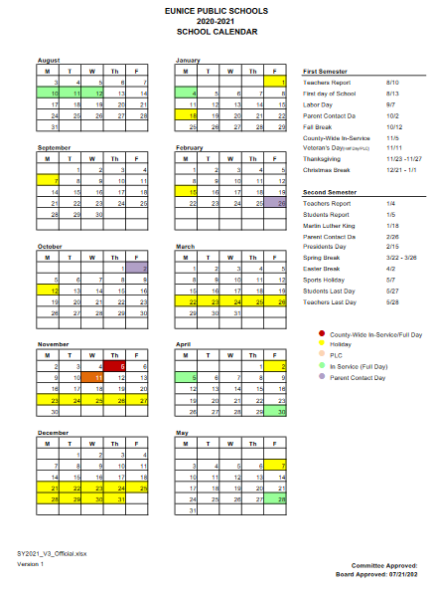
School Calendar

Slide 8
Professional Development
Equity Council; Goals, Strategies, Planning, Support. Activities, Staff member and Timeline:
Goals: To provide professional development for all staff in working with underserved populations.
Access to Simple K-12 Professional Development for all Eunice personnel.
Training designed for the needs of our staff and students presented on a monthly basis.
From Strategic Plan 2018 – 2020
The school district will center its efforts on the following seven focus areas for the duration of this strategic plan:
Aligned Instructional Focus:
Facilities and Infrastructure
Parent and Community Partnerships
Fiscal Support
Recruiting, Retaining, and Developing Staff
Discipline
Safety
The integration of our work in each of these seven focus areas will result in a strengthened instructional program for every student we serve, stronger and more positive relationships with our parents and the community to which we are responsible, and a more effective and collegial faculty and staff delivering those services

Slide 9
Family Engagement
Equity Council; Goals, Strategies, Planning, Support. Activities, Staff member and Timeline:
Goal: To provide and open and transparent forum with the community and families of Eunice.
Eunice will have a social media presence with a school webpage and Facebook page.
1 call service in Spanish and English.
Parent teacher contact days twice a year. (Once per semester)
Distance Learning training for parents.
Posted school re-opening plan approved by school board and NMPED.
Open-Door policy for all staff and administration.
From Strategic Plan 2018 – 2020:
What does this mean? Public schools mean just that: schools funded by the public and pro-vided for the children of the public- our parents and our community. As stakeholders in the success of the school system, parents and com-munity play an important role in helping shape the school system and in the success of students enrolled in the Eunice Public Schools.
Why is this important? Our children are the embodiment of our community. Effective partnerships involve extensive two-way communication between and among all parties. The important role parents play in their children’s success in school is undeniable. The support the broader community provides the school district by way of funding and opportunities for students to experience the real world is also undeniable. The Eunice Public Schools is committed to building stronger and more effective partnerships with parents and the greater community in support of the success of every student.
What we will do to address this focus area: Increase family and community participation in the educational process and the life of the schools. Broaden our students’ awareness of the responsibility to participate in their community. Develop stakeholders’ abilities to demonstrate respectful behavior.

